Slide 1
Insecure Direct Object References
Timo Bonomelli, Patrick Günthard

Slide 2
Vulnrability

Slide 3
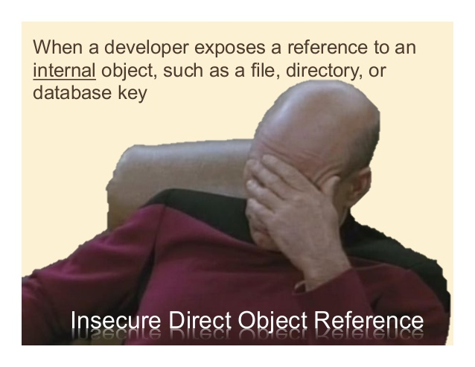
What is Insecure Direct Object References
Notes:
<number>

Slide 4
Threats
Threat Agents: Any user who has only partial access to certain type of system data
Attacker’s Approach: Attacker, an authorized system user, simply changes a parameter value that directly refers to a system object to another object the user isn’t authorized to use
Security Weakness: Applications don’t always verify the user is authorized for target objects

Slide 5
Example: Website
Normal behavior
http://somesite.net/change password?user=myuser
Attack
http://somesite.net/change password?user=otheruser
Change Password for User MyUser
Change Password for User OtherUser
Password
Password
Repeat Password
Repeat Password

Slide 6
Example: Database
Executed Query:
SELECT * FROM useraccounts WHERE account = ”myuser”; INSERT INTO useraccounts (account,password) VALUE(”otheruser”, ”password”);
Other (more evil) possibility:
SELECT * FROM useraccounts WHERE account = ”myuser”; DROP TABLE useraccounts;
Normal behavior
Access:
http://somesite.net/changepassword?user=myuser; INSERT INTO useraccounts VALUE(...)
Java-Code:
String sqlquery = "SELECT * FROM useraccounts WHERE account = ?"; PreparedStatement st = connection.prepareStatement(sqlquery); st.setString( 1, request.getParameter("acct")); ResultSet results = st.executeQuery();

Slide 7
How to prevent an attack
Test: Every parameter coming from the client has to be checked
Authorization: Check everytime if this user is permitet to do access this operation

